Slide 1
Project:-
CAUSE OF DEATHS
SUBMITTED BY:-
AKASH JAISWAL
Notes:
Sumitted by- Kashish Mudgil
Internship-ww

Slide 2
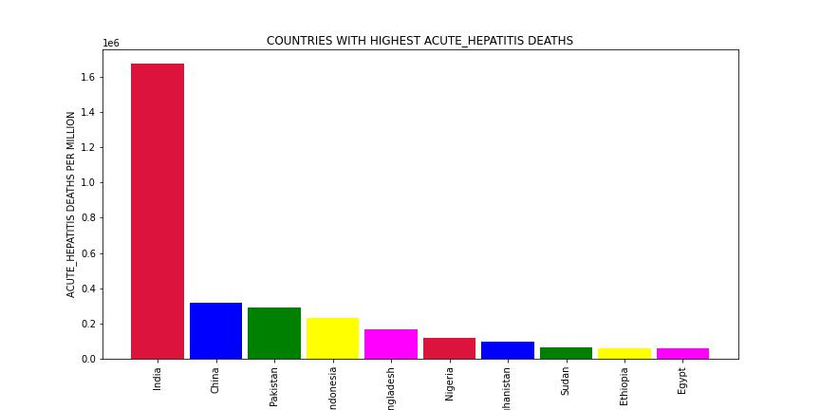
Disease Specific considering Acute Hepatitis

Slide 3
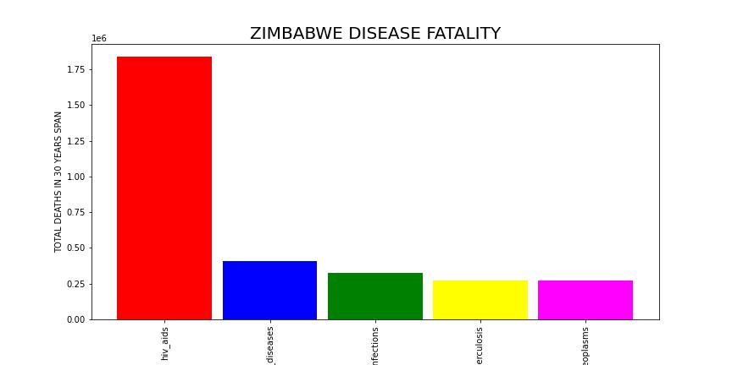
Various Countries Disease Fatality

Slide 4
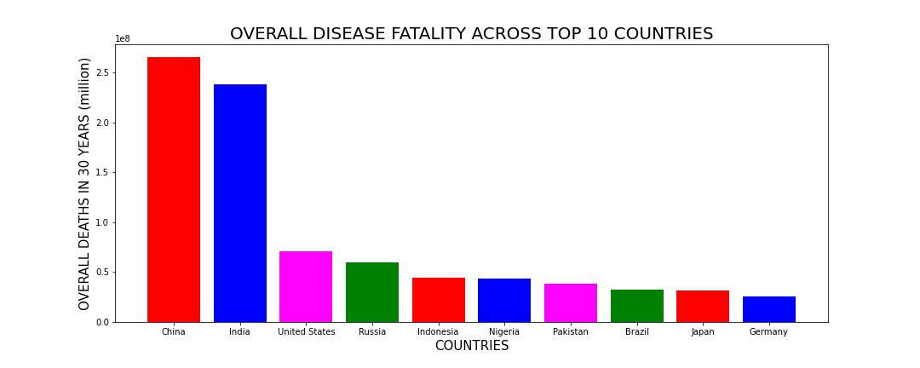
Overall Highest Disease Amongst Countries

Slide 5
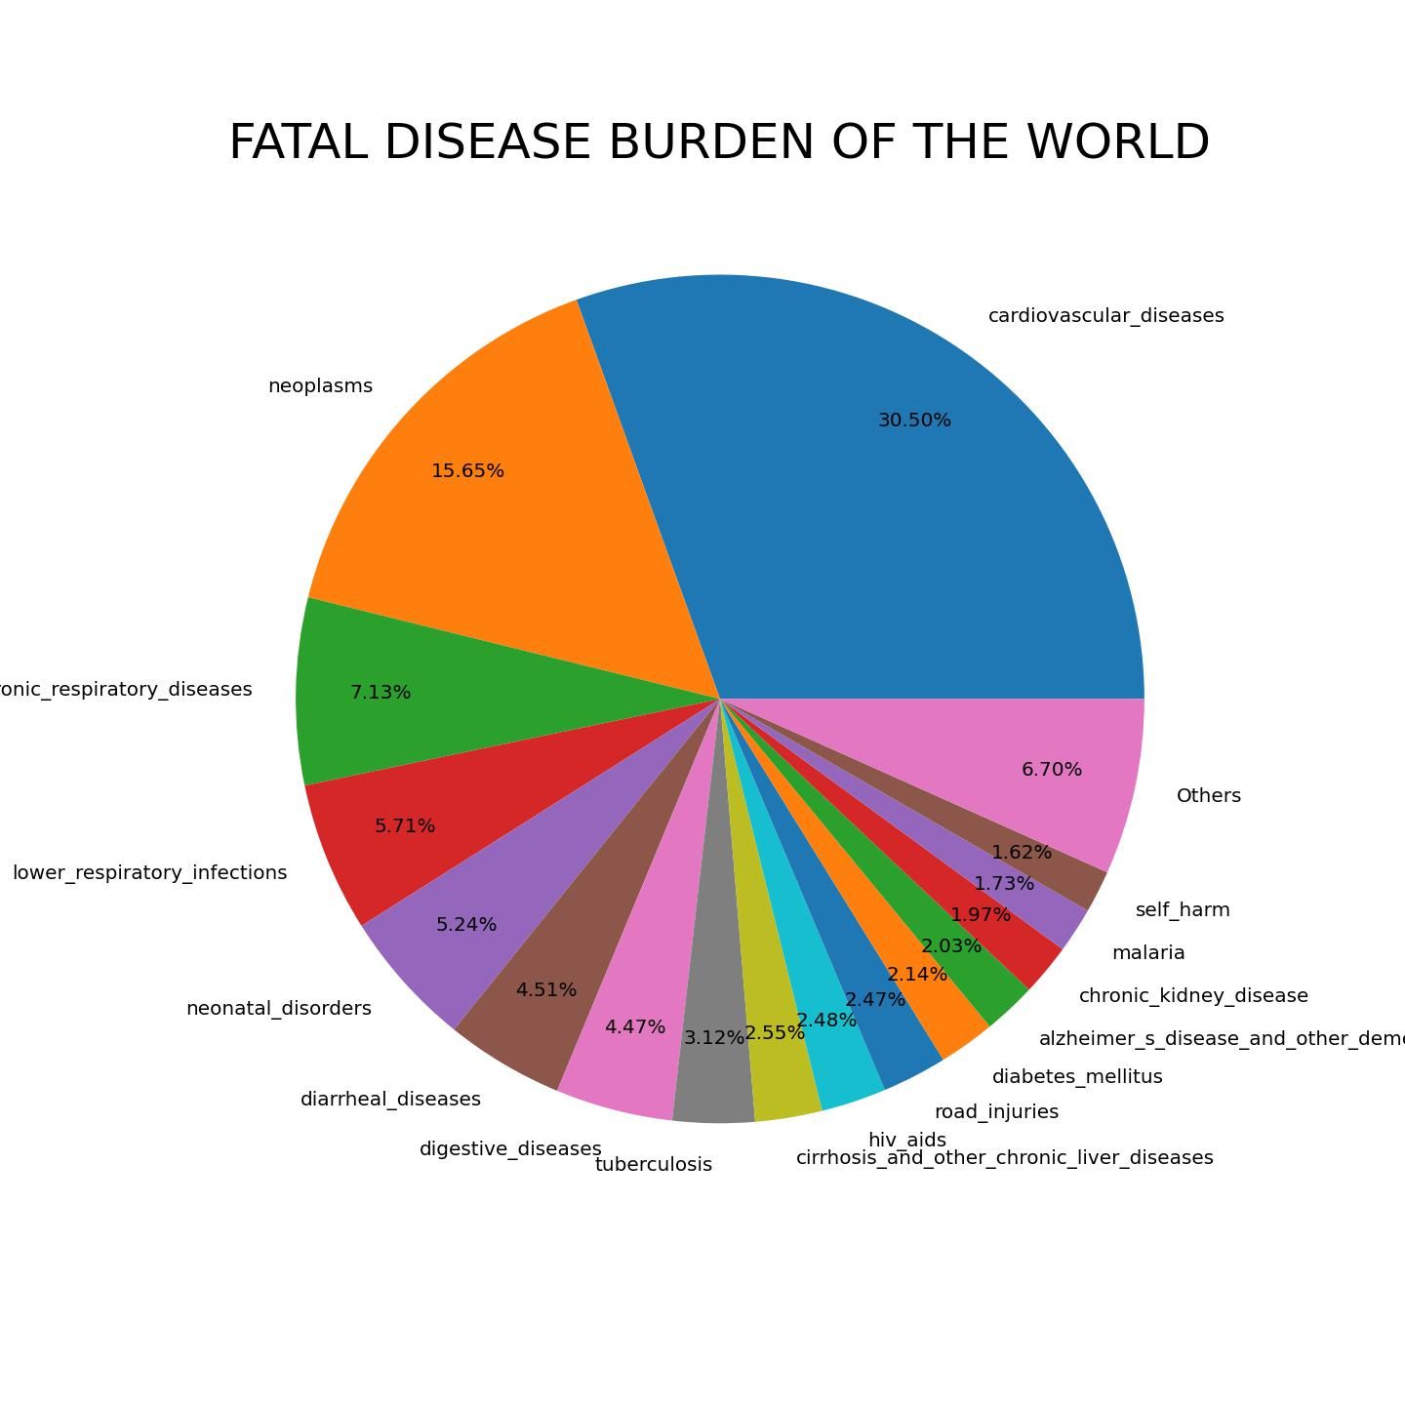
Final

